Slide 1
Consistency
Compilers Autumn 2002

Slide 2
Constrains & invariable
constraints for application in transaction
  Double-linked list
  Disk storage management
  Replica management
  Banking
Compilers Autumn 2002

Slide 3
Interface consistency
Internal operation: --------inconsistency
  Update action requires several steps
Interface: ----------consistency
  Another thread/client asks to read the data
Two consistency models
  Strict consistency
  Eventual consistency
Compilers Autumn 2002

Slide 4
Strict consistency
Hides the constraint violation behind modular boundaries
outside will never see inconsistency
depends on actions honoring abstractions
  for a Cache ： READ get the most recent WRITE
Compilers Autumn 2002

Slide 5
Strict consistency
Using transactions
  All-or-nothing
    Maintain interface consistency despite failures
  Before-or-after
    Maintain interface consistency despite concurrent reading or updating of the same data
Compilers Autumn 2002

Slide 6
Eventual consistency
Scenario
  Performance or availability is a high priority
  Temporary inconsistency is tolerable
  e.g. web browser display rendering
  e.g. New book today but catalog updated next day
  e.g. Loose coupling replica
Compilers Autumn 2002

Slide 7
Eventual consistency
Inconsistency window
  After a replica is updated
  Different observers may even see different results
Compilers Autumn 2002

Slide 8
Cache system
Cache = performance oriented replica system
  Rather than reliability
Invariant
  Data in primary = replica in secondary memory
  How long is the inconsistency window?
  Strict consistency VS. eventual consistency
Interface
  The result of a read of a named object is always the value of the most recent write to that object
Compilers Autumn 2002

Slide 9
Cache consistency
Consistency: either strict or eventual
  Strict: ------ write-through cache
    Performance is affected
  Eventual: no-write-through cache
    Still hold the invariant for the same thread
    What if there’re more than one cache?
    What if another thread has its own cache?
      Even write-through cache fails to keep consistency
Three methods
  Timeout, marking, snoopy
Compilers Autumn 2002

Slide 10

Eventual consistency with timer expiration
Example: DNS cache
  Client ask for IP for “ginger.pedantic.edu”
  Then network manager change IP of “ginger.pedantic.edu” on “ns.pedantic.edu”
TTL (Time To Live)
  One hour as default
  Keep old IP available during the TTL
  E.p. (1) one hour, (2) five minutes
Compilers Autumn 2002

Slide 11
10.2.3 Strict consistency with a fluorescent marking pen
A few variable are shared and writable
  Server marks a page as “don’t cache me”
  Browser will not cache the page
The “volatile” variable
  Ask the compiler to ensure read/write consistency
    Write register back to memory
    Flush memory
    Block instruction reordering
Compilers Autumn 2002

Slide 12
10.2.4 Strict consistency with the snoopy cache
Invalidate cache entries when inconsistent
  When several processors share the same secondary memory
  Primary cache usually be private
  Write-through doesn’t change cache in other processor
  Naïve solution: invalidate everything in cache if write
  Better idea: specify the cache line
    Each private cache monitor the memory bus
    Even grab the value of write and update
Compilers Autumn 2002

Slide 13
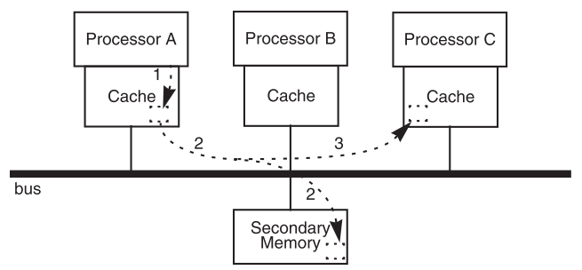
Processor A writes to memory
Write-through the cache, to memory by bus
Cache of B & C snoop on the bus and update the replica
Compilers Autumn 2002

Slide 14
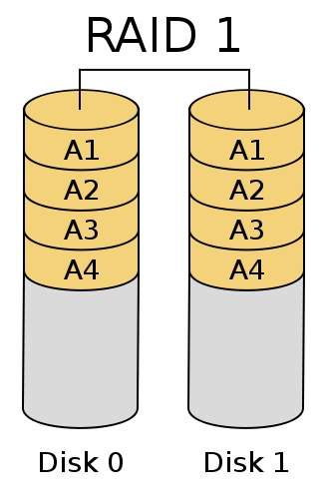
Mirroring -- RAID
Mirroring
  On physical unit basis
  E.g. RAID-1
  Protect against internal failures
  of individual disks
Issues
  What if the OS damages the data before writing?
  What if fire /earthquake
    Placing matters: geographically separated
Compilers Autumn 2002

Slide 15
Distributed replica server
Separate replicas geographically （network）
  High latency
  Unreliable communication
  ➔ Hard for synchronously
asynchronously
  Primary copy + backup copies
  Master V.S. Slaves
  Not always identical
Compilers Autumn 2002

Slide 16
How to Update the replicas
Logic copies:
  file-by-file， record-by-record
  Understandable to the application
  Lower performance
Physical copies: sector-by-sector
More complex
  Crash during updates
  Multiple replica ----→ Performance（读）
  (strict) consistency -→ performance （写）
Compilers Autumn 2002

Slide 17
Replicated state machine (RSM)
Why complex?
  Updating
Replicated state machine
  Identify the data with the state of a Finite State Machine (FSM)
  The inputs of FSM are the updates
  The state of each replicate should match one another
Compilers Autumn 2002

Slide 18
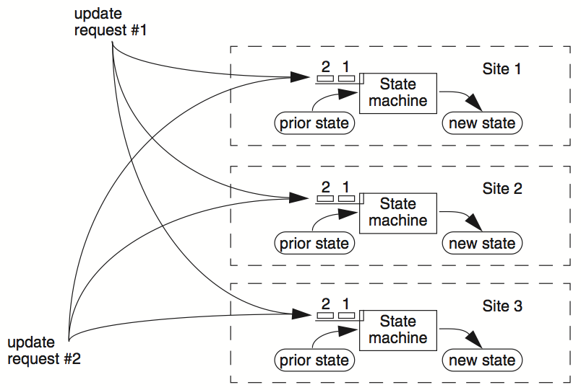
Compilers Autumn 2002

Slide 19
Replicated state machine
1. Same inputs, same order
  Consensus: agree on the values and order of inputs at separated sites
  The consensus problem
    Achieve agreement on a single binary value
    Among sites that don’t share a common clock and separated by a best-effect network
    Impossible to solve with certain kinds of failures
  Apply bootstrapping to agreement if solving the problem
2. All replicas must be identical
  Check for decay events that drifting
  Reconciliation: identify differences and correct
Compilers Autumn 2002

Slide 20
Replicated state machine
3. RSM must also be identical
  Harder to achieve
  Environment may affect the behavior
    Transient faults
  Can also use reconciliation
4. RSM may contain identical implementation faults
  Reconciliation NOT working
Compilers Autumn 2002

Slide 21
Single state machine 10.3.3
Single state machine
  Carry out all updates at one replica site
  Generate a new version at that site
  Bring the other replicas into line
    Brute force copying: copy the whole new version to others
  Conditions
    Occasionally update
    Small database
    No urgency to make updates available, so batch is OK
    Temporary inconsistency can be tolerated
Compilers Autumn 2002

Slide 22
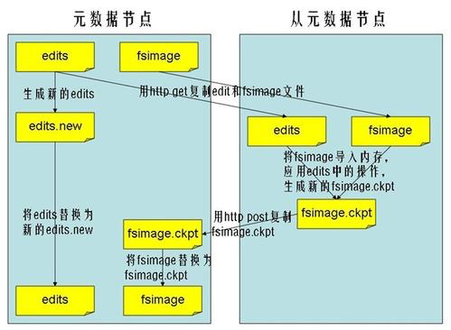

Slide 23
Single state machine (cont.)
SSM is subject to data decay, but:
  decay of the master maybe to all
  Decay in slaves --- until next update
Main defect of SSM
  Single point failure----the master (bad)
  (worse) What if fails in the middle of updating?
  So ,Doesn’t work well for large database
Compilers Autumn 2002

Slide 24
HDFS：文件读取 流程图
NameNode
HDFS
client
1:open
Distributed
FileSystem
2:get block locations
3:read
namenode
6:close
FSData
InputStream
client JVM
client node
5:read
4:read
DataNode
DataNode
DataNode
datanode
datanode
datanode

Slide 25
HDFS：文件写入 流程图
2:create
NameNode
HDFS
client
1:create
Distributed
FileSystem
3:write
7:complete
namenode
6:close
FSData
InputStream
client JVM
client node
4:write packet
5:ack packet
DataNode
4:
DataNode
4:
DataNode
Pipeline of
datanodes
5:
5:
datanode
datanode
datanode
HDFS中的文件都是一次性写入的，并且严格要求在任何时候只能有一个写入者。

Slide 26
2 phase commit

Slide 27
Enhancements of single state machine
Master only distributes deltas ∆
  Pros: may produce a performance gain
  Cons: has disadvantages of both SSM & RSM
Reduce inconsistency window
  E.g. shadow copy (just as two-phase commit ???? )
Partition large database
  Each of which can be updated independently
  Assign a different master to each partition
    Distribute updating work, increase availability of update
Compilers Autumn 2002

Slide 28
Enhancements of single state machine
Add fault tolerance when master fails
  Using a consensus algorithm to choose a new master site
If data is insensitive to update order, then consensus algorithm is not needed
  E.g. email, users may see different order, eventually correct order
Master can distribute just its update log
  Replica sites can run REDO on log
  Replica sites can only maintain a complete log

Slide 29
Maintaining data integrity
Threats of data integrity in updating a replica
  Data can be damaged or lost
  Transmission can introduce errors
  Operators can make blunders
Solutions
  Periodically compare replicas bit-by-bit
    To check spontaneous data decay
  Calculate a witness of the contents to compare
    E.g. by choosing a good hash algorithm
    Just as checksum in end-to-end layer, link layer
Compilers Autumn 2002

Slide 30
Replica reading and majorities
Simplest plan
  Read and write from master, slaves are only backups
  Master always return the last write (strict consistency)
Enhancement for read availability
  Allow reading replica
  Also enhance performance
  But consistency may be violated
    need before-or-after between reads and updates
To maintain integrity
  Read witness,
  Use majority for reading
Compilers Autumn 2002

Slide 31
Quorum
Define separate read &write quorums: Q_{r} & Q_{w}
  Q_{r} + Q_{w} > N_{replicas} (Why?)
    Confirm a write after writing to at least Q_{u} of replicas
    Read at least Q_{r} agree on the data or witness value
Example
  In favor of reading: N_{replicas} = 5, Q_{w} = 4, Q_{r} = 2
  In favor or updating: N_{replicas} = 5, Q_{w} = 2, Q_{r} = 4
  Enhance availability by Q_{w} = N_{replicas} & Q_{r} = 1
Compilers Autumn 2002

Slide 32

Replicated-Write Protocols
Compilers Autumn 2002

Slide 33
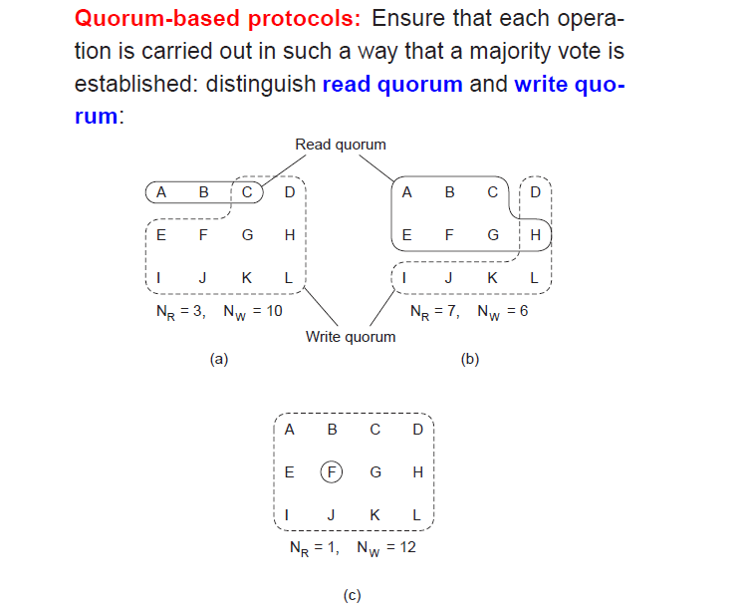
Replicated-Write Protocols
Compilers Autumn 2002

Slide 34
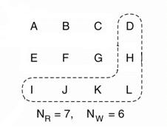
A wrong choice
Figure: A choice that may lead to write-write conflicts
Compilers Autumn 2002

Slide 35
Quorum
Provide no before-or-after or all-or-nothing
  If reading & writing requests come from a site
    Easy…
  If reading from multiple sites, writing from one site
    Maintain a version number at that site
  If writing from multiple sites
    Protocol providing a distributed sequencer
Compilers Autumn 2002

Slide 36
Backup
Time consuming
  Incremental backup
  Partial backup
    Don’t copy files that can be reconstructed from other files
When to backup?
  In the middle of updating may violate consistency
Replicated failures by the same programming
  Independence of failures should be enforced
Folk wisdom
  elaborate system, fail working
Compilers Autumn 2002

Slide 37
Partitioning data
Partitioning data to tolerate failure
  Place each part on a different physical device
  Easy to explain to users, inexpensive
  Improve performance
Combine replication with partition
  Partition is replicated
Compilers Autumn 2002

